Slide 1
WELCOME !

Slide 2

Department of Computer Science & Engineering Artificial Intelligence & Machine Learning
A.P. Shah Institute of Technology, G.B.Road, Kasarvadavli, Thane(W), Mumbai-400615, UNIVERSITY OF MUMBAI, Academic Year 2023-2024

Slide 3

WEATHER FORECAST APPLICATION
Computer Science & Engineering Artificial Intelligence and Machine Learning
By
Krishna Dongre (22106089)
Tanveer Angane (22106057)
Siddharth Chaurasiya (22106060)
Anish Gawade (22106109)
Under the Guidance of
Prof. Vijaya Bharathi

Slide 4
INDEX
Introduction
Objectives
Features
Literature Survey
Tools/Softwares, Languages Used
Implementation
Conclusion
Reference

Slide 5
INTRODUCTION
This weather web application gives real-time data on various weather parameters such as temperature, humidity, wind speed and accurate weather forecast prediction
Weather web application offers personalized experiences by allowing users to set their locations and preferences.
In some or other way our daily lives are dependant on the weather conditions. It has been always essential to know the regular updates of weather, as it continuously varies with every passing day.
The Weather forecast is a big thing that enabled many of us to stay notified about the changes in climatic conditions beforehand.

Slide 6
OBJECTIVE
This project aims to address the following key objectives:
Accurate Weather Data :To provide users with reliable and precise weather data sourced from reputable meterological organistions and data providers.
User-Friendly Interface : To create an intuitive and visually appealing user interface that allows users to easily access and interpret weather information.

Slide 7
OBJECTIVE
Comprehensive Weather Details : To Provide detailed and in-depth set of information about current weather conditions.
Real-time Updates : To deliver real-time weather updates and notifications to users to keep them informed about changing weather conditions.

Slide 8
FEATURES
Google-Map based
Hourly Forecast
Sunrise and Sunset Times
Air Quality Data
Location Based Forecasting

Slide 9
BLOCK DIAGRAM
HTML
CSS
(client side)
FIVE ROOT
(server)
WEATHER
DATA
APIs
BROWSER

Slide 10
How Does API Work?
Here's how APIs work:
Data Request
API Processing
Data Retrieval
Data Transmission
Data Integration
Basically it serves as a bridge between the application to access and retrieve data, from an external source

Slide 11
LITERATURE SURVEY
Sr.No | Title | Method | Limitations
1. | An Intelligent Early Flood Forecasting and Prediction Leveraging Machine and Deep Learning Algorithms with Advanced Alert System | Historical Weather Pattern | Do not incorporate real-time data, such as current atmosphere condition.
2. | Weather Prediction for Tourism Application using Time Series Algorithm | Time series algorithm | Require prior knowledge of sensed data
3. | The usefulness of medium range weather forecast | Medium range weather forecast | Limited range forecast

Slide 12
LITERATURE SURVEY
Sr.No | Title | Method | Limitations
4. | Review on Weather Application | 3-D Cloud Pattern | Require high resolution,significant Computational resources
5. | Rice-irrigation automation using a fuzzy controller and weather fore | Fuzzy logic (Weather forecast data & crop characterstics) | Used for short term weather forecast and less sutiable for long term weather forecast
6. | Integrating Local Farmers Knowledge Systems in Rainfall Prediction | Farmers traditional knowledge system | Depends on farmers experience and accuracy

Slide 13




TOOLS/SOFTWARE , LANGUAGE USED
JAVA SCRIPT
HTML
CSS
API KEY

Slide 14
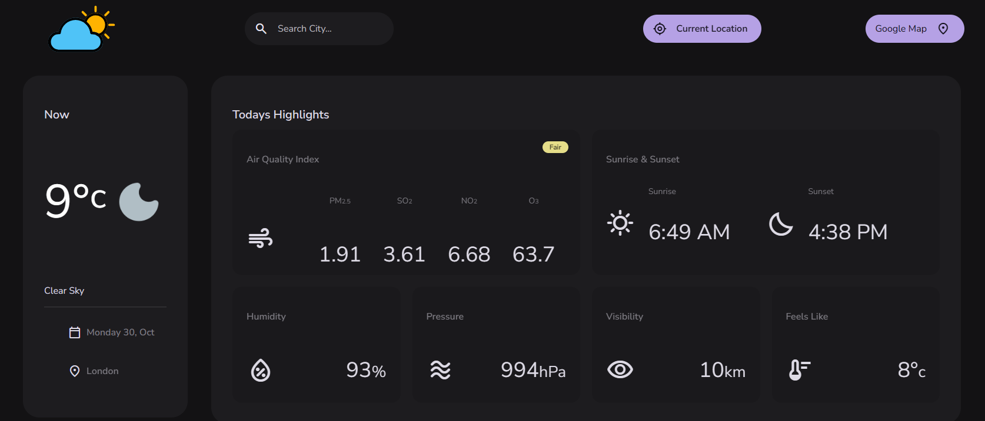
IMPLEMENTATION:
Here we completed the weather application.

Slide 15
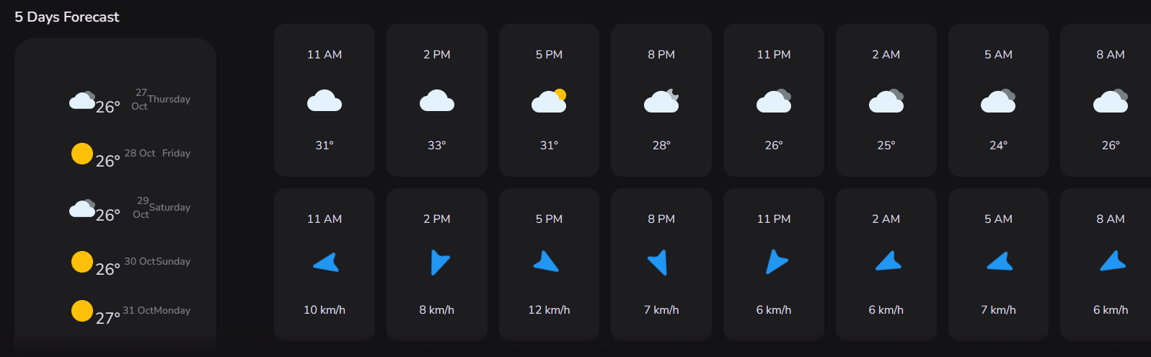
IMPLEMENTATION:

Slide 16
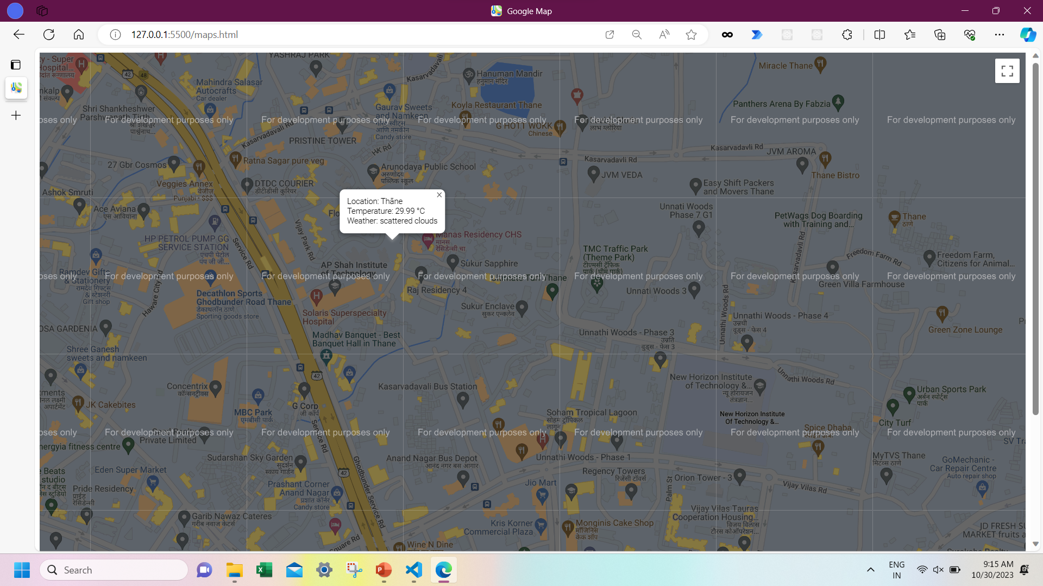
IMPLEMENTATION

Slide 17
CONCLUSION
A weather application is an essential tool in today's fast-paced world, providing users with valuable information about current and forecasted weather conditions.
In conclusion, the weather application project has successfully achieved its implementation.

Slide 18
REFERENCES
https://scholar.google.co.in/scholar?q=An+Intelligent+Early+Flood+Forecasting+and+Prediction+Leveraging+Machine+and+Deep+Learning+Algorithms+with+Advanced+Alert+System&hl=en&as_sdt=0&as_vis=1&oi=scholart [1]
https://scholar.google.co.in/scholar?hl=en&as_sdt=0%2C5&as_vis=1&q=Weather+Prediction+for+Tourism+Application+using+Time+Series+Algorithm&btnG= [2]
https://scholar.google.co.in/scholar?hl=en&as_sdt=0%2C5&as_vis=1&q=Prediction+Based+Data+Reduction+and+Controlled+Transmission+in+Wireless+Sensor+Network+for+Weather+Forecasting&btnG= [3]
https://scholar.google.co.in/scholar?hl=en&as_sdt=0%2C5&as_vis=1&q=Rice-irrigation+automation+using+a+fuzzy+controller+and+weather+forecast&btnG= [4]
https://scholar.google.co.in/scholar?hl=en&as_sdt=0%2C5&as_vis=1&q=Integrating+Local+Farmers+Knowledge+Systems+in+Rainfall+Prediction+and+Available+Weather+Forecasts+to+Mitigate+Climate+Variability%3A+Perspectives+from+Western+Kenya&btnG= [5]

Slide 19
THANK YOU !

